Slide 1


Micron-BERT: Advancing Facial Micro-Expression Recognition
Micron-BERT (µ-BERT) is a deep learning model designed to recognize subtle facial micro-expressions, those involuntary flickers lasting just 0.25 to 0.5 seconds, often missed by the human eye. By leveraging a BERT-based architecture, µ-BERT captures minute facial changes across video frames, significantly enhancing micro-expression recognition.
by Prince Kushwaha

Slide 2



Understanding Facial Expressions: Macro vs. Micro
Macro-Expressions
Micro-Expressions
Large, easily recognizable facial movements lasting 0.5 to 4 seconds. These are the expressions we consciously display and interpret in daily interactions.
Tiny, involuntary facial movements lasting 5 milliseconds to 0.5 seconds. They are difficult to detect and often reveal concealed emotions.
Facial expressions are classified into macro-expressions and micro-expressions. Macro-expressions are large movements lasting 0.5 to 4 seconds that are easily recognizable. Micro-expressions are tiny, involuntary facial movements lasting 5 milliseconds to 0.5 seconds, which are difficult to detect.

Slide 3
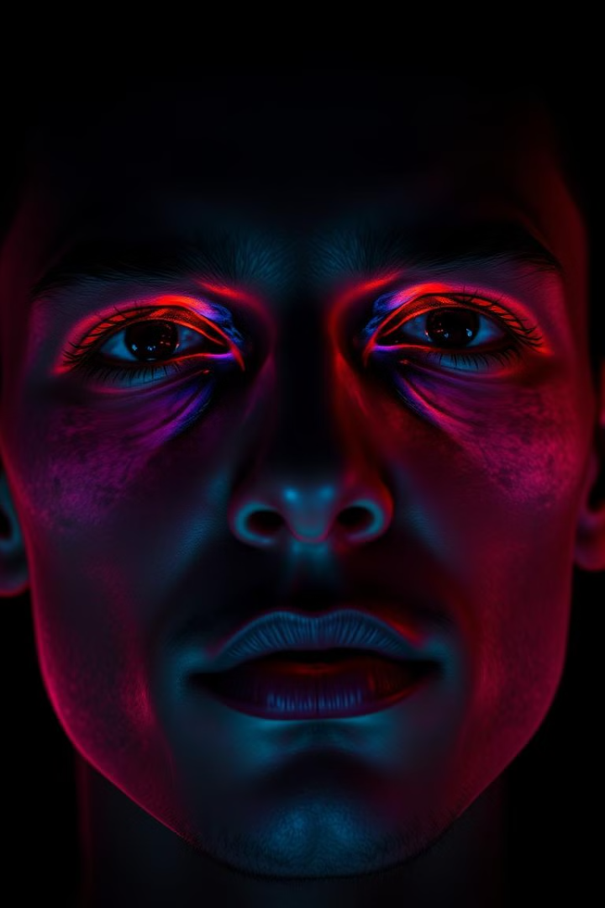







Challenges in Recognizing Micro-Expressions
Low Intensity
The movements are very subtle and hard to see.
Short Duration
Expressions last only a fraction of a second.
High-Speed Cameras
Require cameras that capture at least 200 FPS.
Background Noise
Variations in facial features and lighting complicate detection.
Micro-expression recognition faces several challenges, including the low intensity and short duration of expressions. High-speed cameras are needed to capture these subtle movements, and background noise and facial variations further complicate the process.

Slide 4
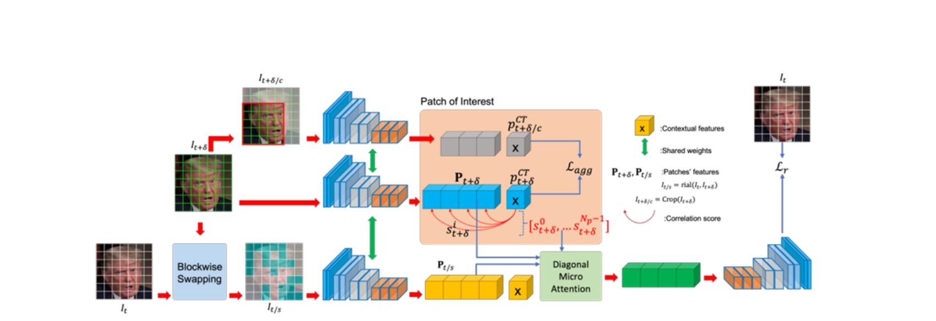



An overview of the proposed µ-BERT approach to facial micro-expression recognition

Slide 5
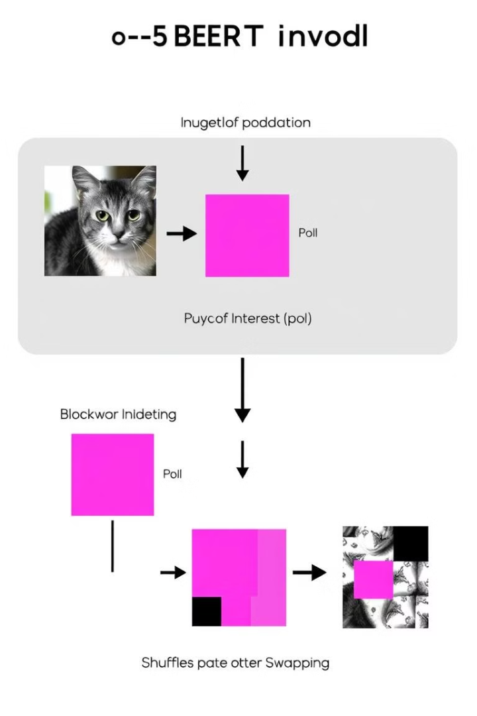




µ-BERT: Key Processing Steps
Image Input
Divide facial image into non-overlapping patches.
µ-Encoder
Transform patches into latent vectors with positional encoding.
Patch of Interest (PoI)
Focus on relevant facial regions like eyes and mouth.
Blockwise Swapping
Swap patches from consecutive frames to highlight differences.
µ-BERT involves several key processing steps. First, the input facial image is divided into non-overlapping patches. The µ-Encoder then transforms these patches into latent vectors, incorporating positional encoding. The Patch of Interest (PoI) module focuses on relevant facial regions, and blockwise swapping highlights differences between consecutive frames.

Slide 6
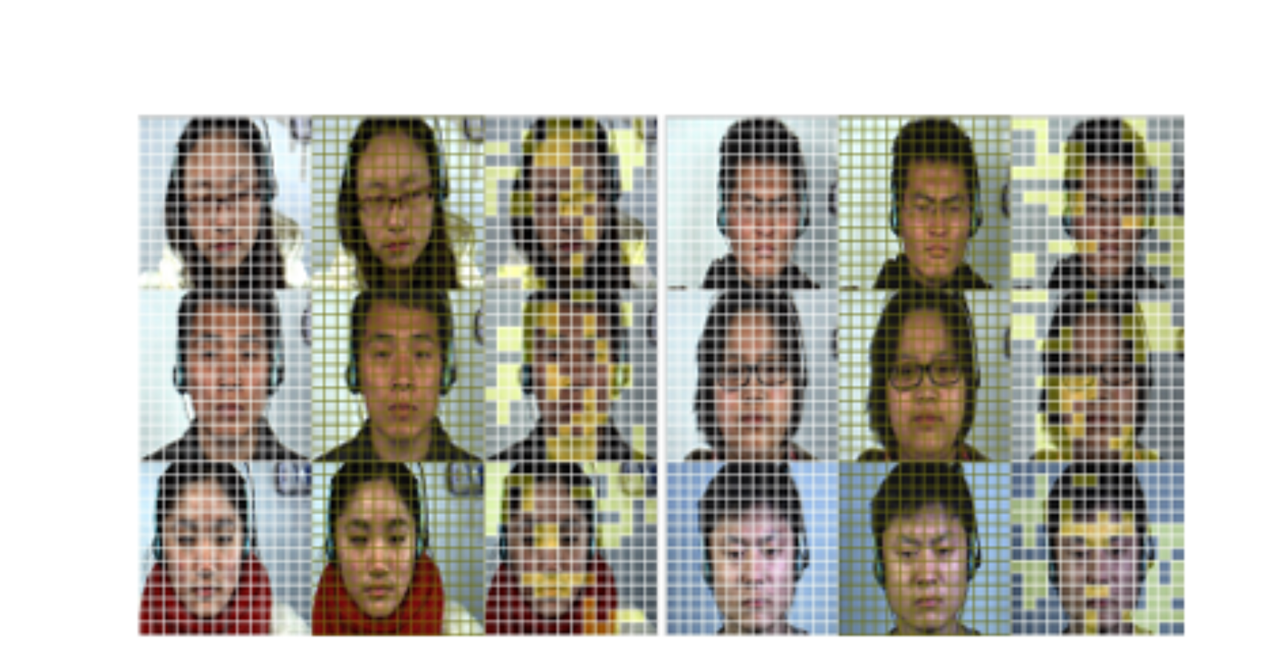




Blockwise Swapping

Slide 7


Diagonal Micro-Attention (DMA) and µ-Decoder
Diagonal Micro-Attention (DMA)
µ-Decoder
Identifies subtle differences between corresponding patches by calculating the attention map and focusing on diagonal elements.
Reconstructs the image based on latent vectors, helping the model focus on micro-expression regions and perform classification.
Diagonal Micro-Attention (DMA) identifies subtle differences between patches by focusing on the diagonal elements of the attention map. The µ-Decoder then reconstructs the image based on latent vectors, helping the model focus on micro-expression regions and perform classification.

Slide 8
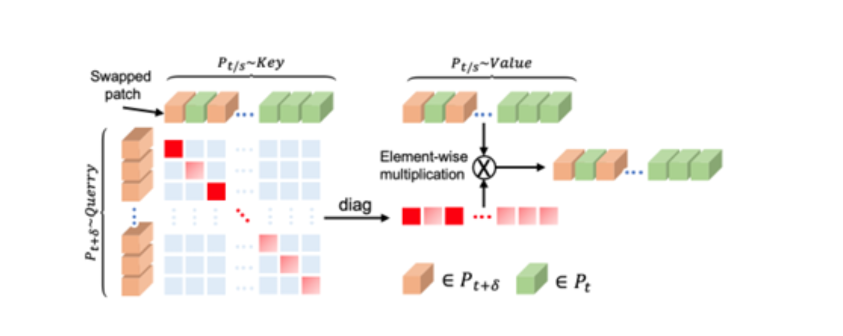


Diagonal Micro-Attention (DMA) module.

Slide 9
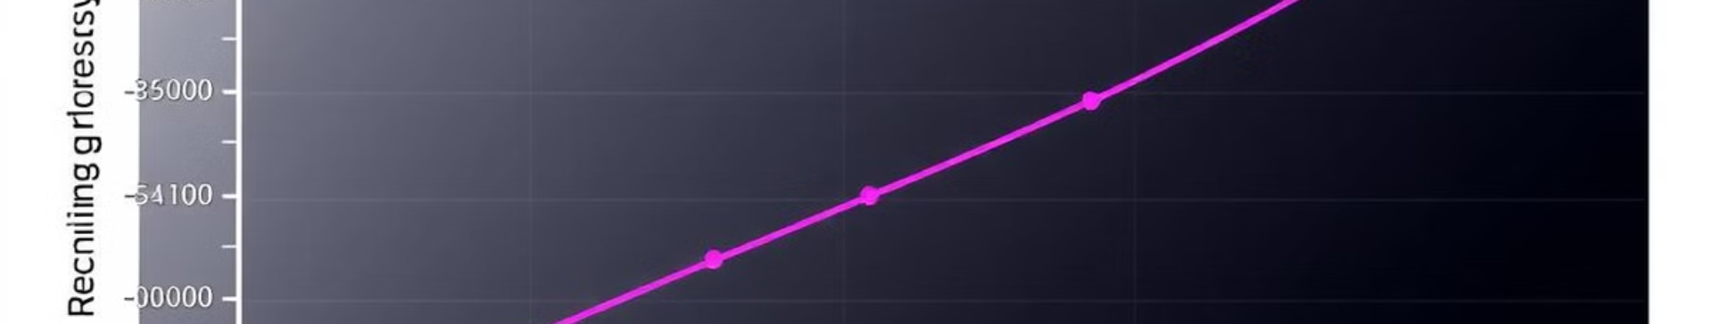


Loss Functions: Reconstruction and Contextual Agreement
Reconstruction Loss (Lr)
Contextual Agreement Loss (Lagg)
Ensures accurate reconstruction of input images, maintaining essential details.
Forces the model to focus on meaningful patches, filtering out irrelevant information.
The model uses two key loss functions. Reconstruction Loss (Lr) ensures accurate reconstruction of input images, while Contextual Agreement Loss (Lagg) forces the model to focus on meaningful patches, filtering out irrelevant information.

Slide 10
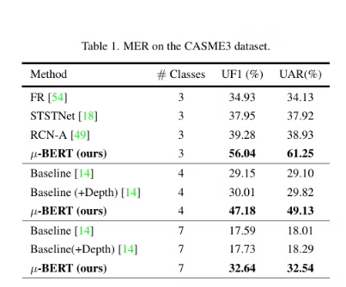
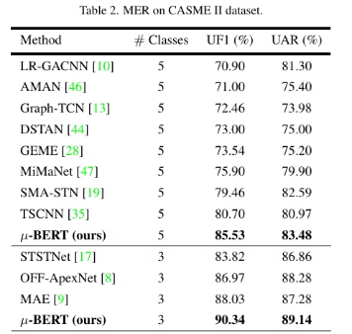
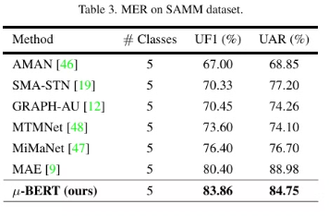
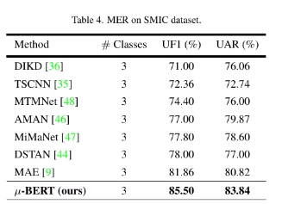


Result
MER on SAMM dataset
MER on SMIC dataset
MER on the CASME3 dataset
MER on CASMEII dataset

Slide 11
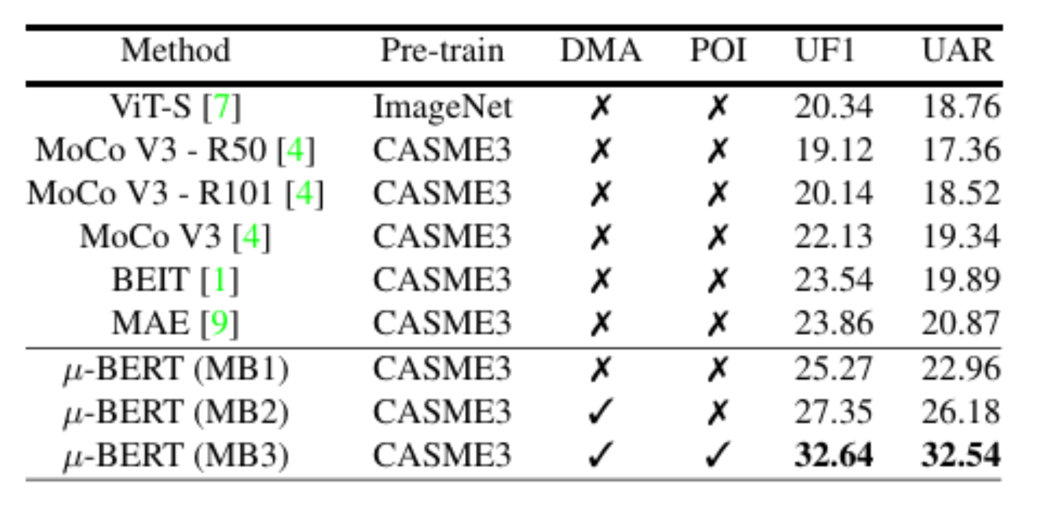


Ablation studies
MER performance on CASME3 by different self supervised methods and various settings of µ-BERT

Slide 12




µ-BERT: Conclusions and Discussions
Diagonal Micro-Attention (DMA)
Novel approach to learn micro-movements across frames.
Patch of Interest (POI) module
Guides the network to focus on salient facial regions.
State-of-the-Art Performance
Achieved on four benchmark datasets.
µ-BERT introduces a novel Diagonal Micro-Attention (DMA) to learn micro-movements across frames and a Patch of Interest (POI) module to focus on salient facial regions. Empowered by this design, µ-BERT achieves state-of-the-art performance on micro-expression recognition tasks in four benchmark datasets.

Slide 13




Limitations and Future Work
Lighting Sensitivity
Noisy factors from lighting conditions might be included as micro-difference features.
Future Work
Robustness under different lighting conditions will be explored.
The POI module's efficiency in removing background noise is sensitive to lighting and illumination. Future work will focus on improving robustness under different lighting conditions to address this limitation.

